Slide 1
Unity 03: VR
CCLab 2016

Slide 2
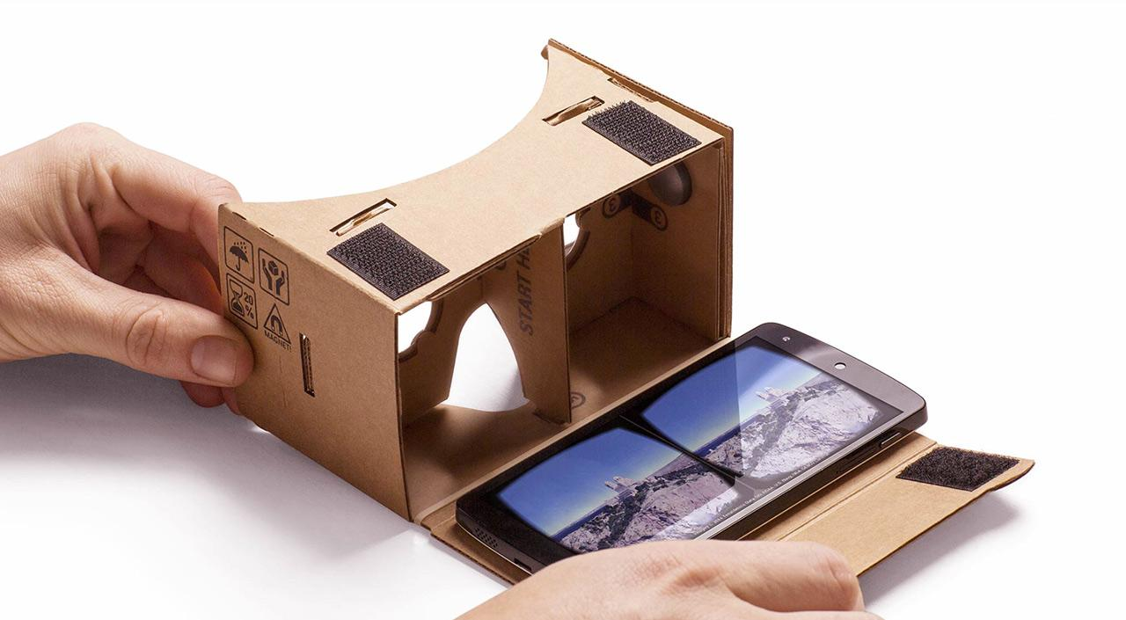
Google Cardboard
Notes:
Accessible, affordable, great for trying out VR, great for prototyping

Slide 3
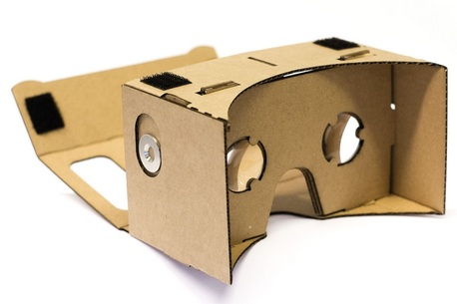
V1.0
Bi-convex lenses for pincushion optical distortion
Your phone as screen (up to 5.2 in)
Magnetic input switch (works on some devices)
Enclosure for sensory deprivation
Notes:
Cardboard V1.0 was released in 2014.

Slide 4
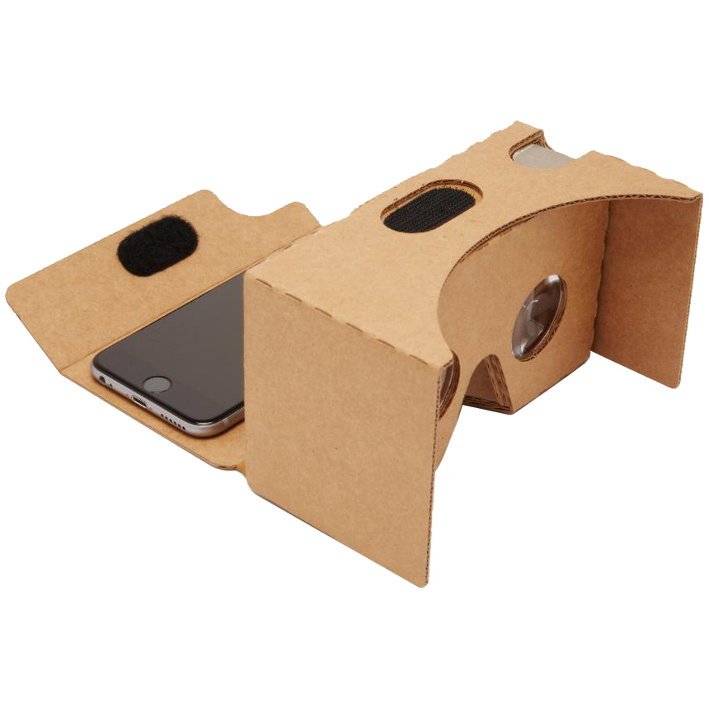
V2.0
Capacitive indirect touch button (works with all smartphones)
Bi-convex lenses for pincushion optical distortion
Your phone as screen
(4.7 - 6 in)
Enclosure for sensory deprivation
Notes:
Main advantage of Cardboard V2.0 is now you have a reliable input button to use in games or interactions.

Slide 5
Software on the phone: splits the display image into two (one for each eye), and applies barrel distortion to counter the lens pincushion distortion - this creates a stereoscopic image that feels 3D.
Notes:
Yay optics!

Slide 6
Google Cardboard Software
Google makes 3 software development kits for Cardboard:
Android, iOS, and Unity
We will download the Cardboard SDK for Unity, create a simple VR enabled interaction, and port the project into Android and/or iOS

Slide 7
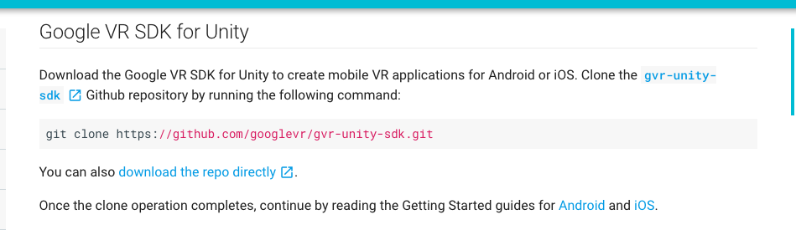
Google VR SDK for Unity
download here: https://developers.google.com/vr/unity/download

Slide 8
What is an SDK?
SDK, or Software Development Kit is “typically a set of software development tools that allows the creation of applications for a certain software package, software framework, hardware platform, computer system, video game console, operating system, or similar development platform.” - Wikipedia
When developing for iOS or Android, SDKs are critical - Android apps require Java SDKs, iOS apps require Swift SDKs. Some SDKs allow the developer to enrich apps with advanced functionalities, ads, notifications, etc.

Slide 9
VR Integration for a 3D project
Open up the 3D Roll a Ball project from Unity Week 1 or an existing 3D project you would like to VR-ify.
Notes:
Refer to project & code in Google Drive Week 3 folder

Slide 10
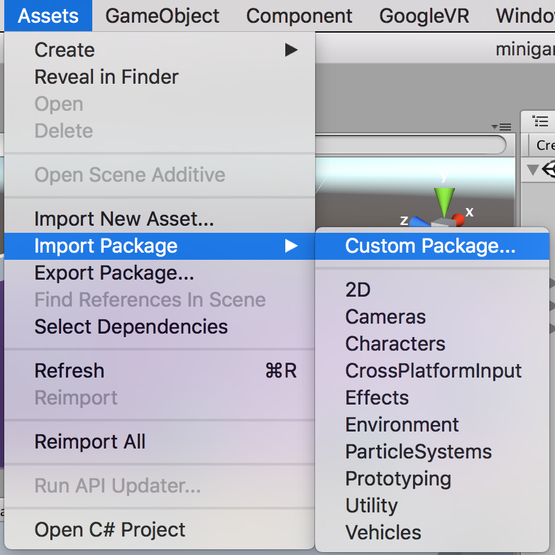
Import the Google VR Unity package by going to Assets > Import Package > Custom Package.

Slide 11
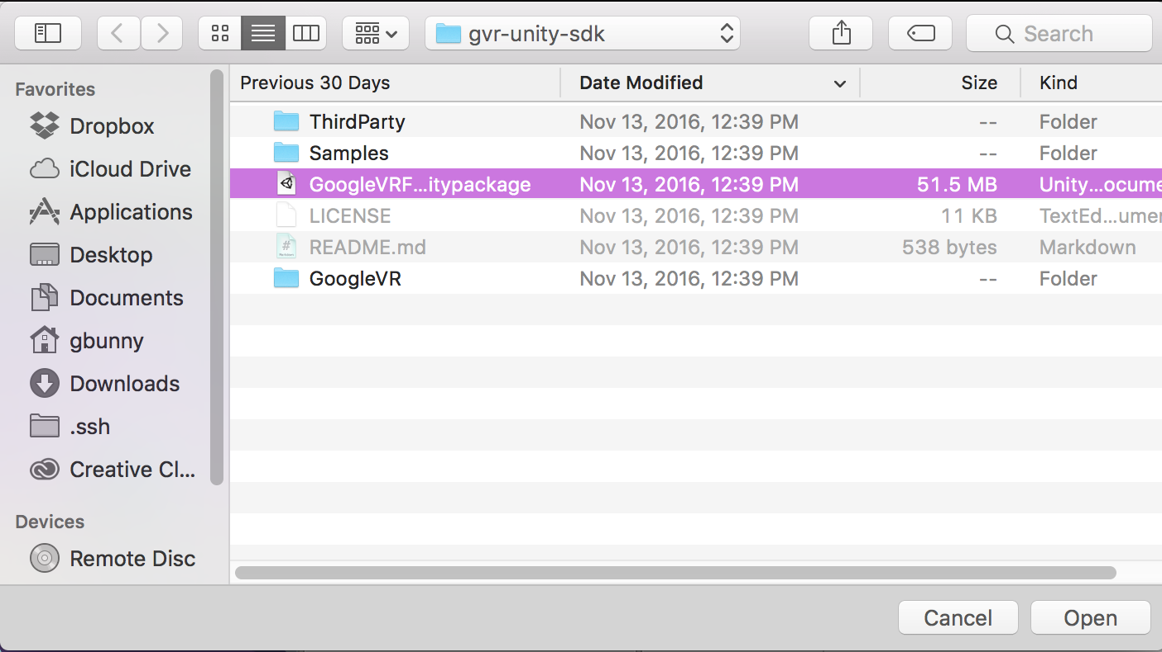
Select the GoogleVRForUnity.unitypackage file you downloaded and click Open. Make sure all the boxes are checked in the Importing Package dialog (minus demo scenes) and click Import. Accept any API upgrades if prompted.

Slide 12
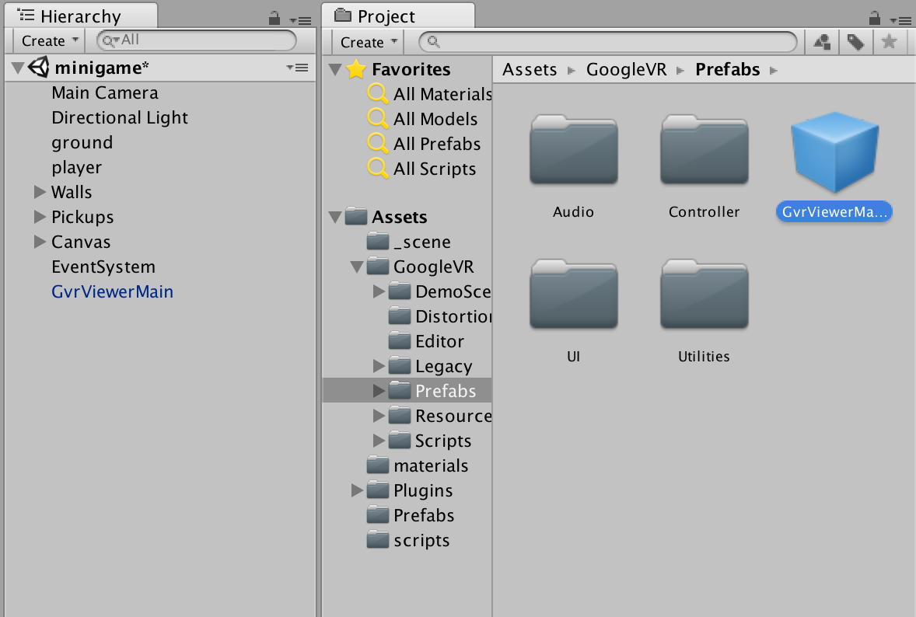
In the GoogleVR -> Prefabs folder, find the GvrViewerMain prefab. Bring it into the Hierarchy and position it to be in the same transform position as the Main Camera

Slide 13
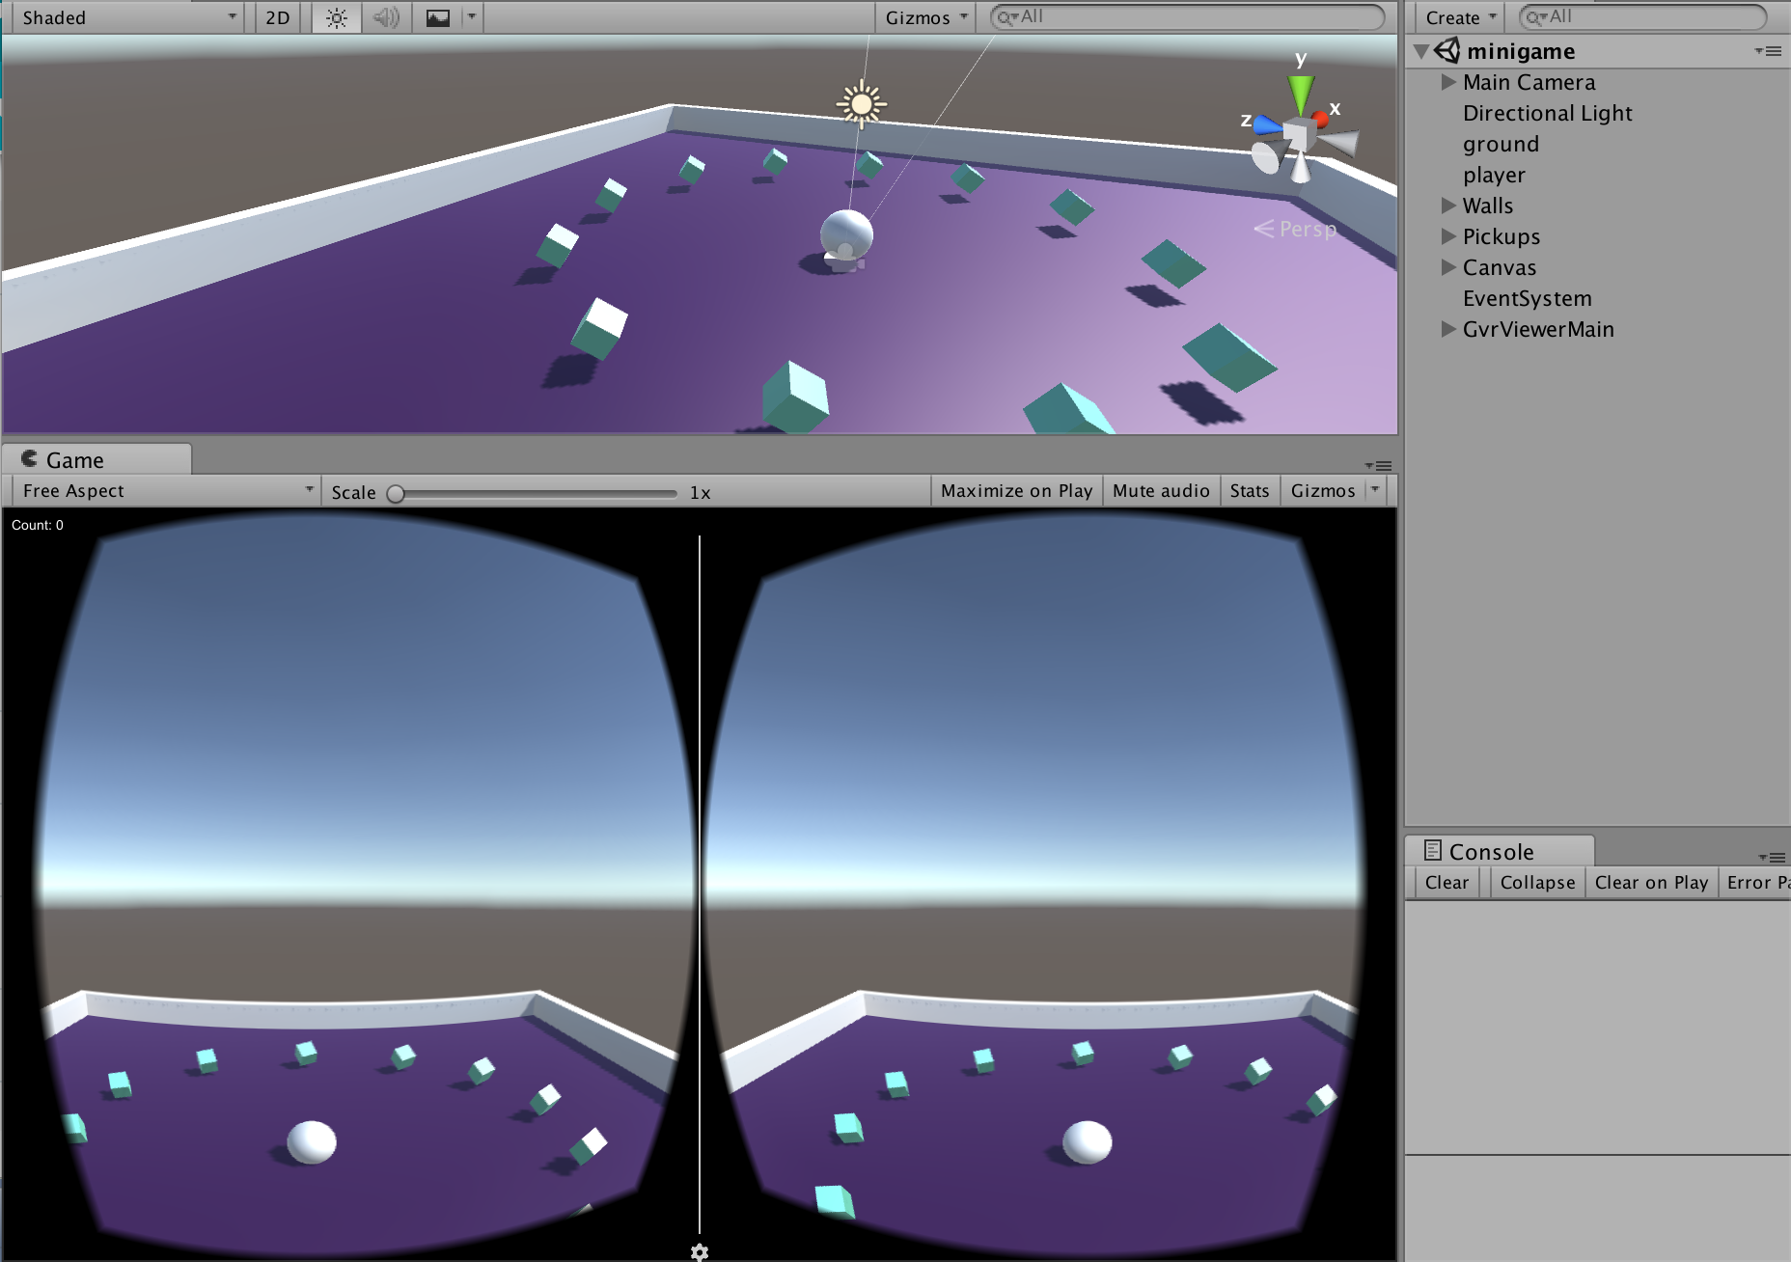
Press play to test that your camera is now in VR mode. You should see Left and Right Camera components inside the Main Camera. Use “alt” + mouse to move the view around in VR mode

Slide 14

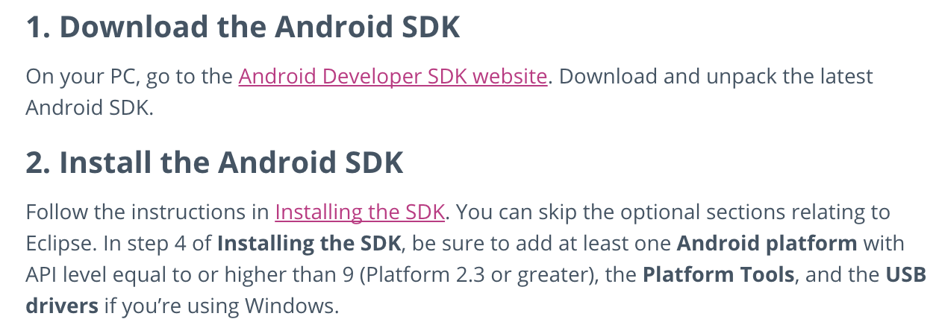
Deploying to Android
https://developer.android.com/studio/index.html
Notes:
https://docs.unity3d.com/Manual/android-sdksetup.html

Slide 15
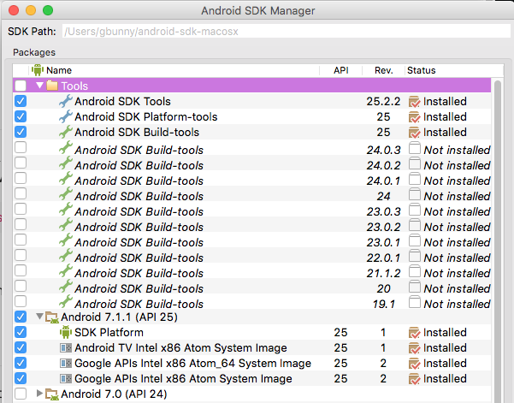

Slide 16
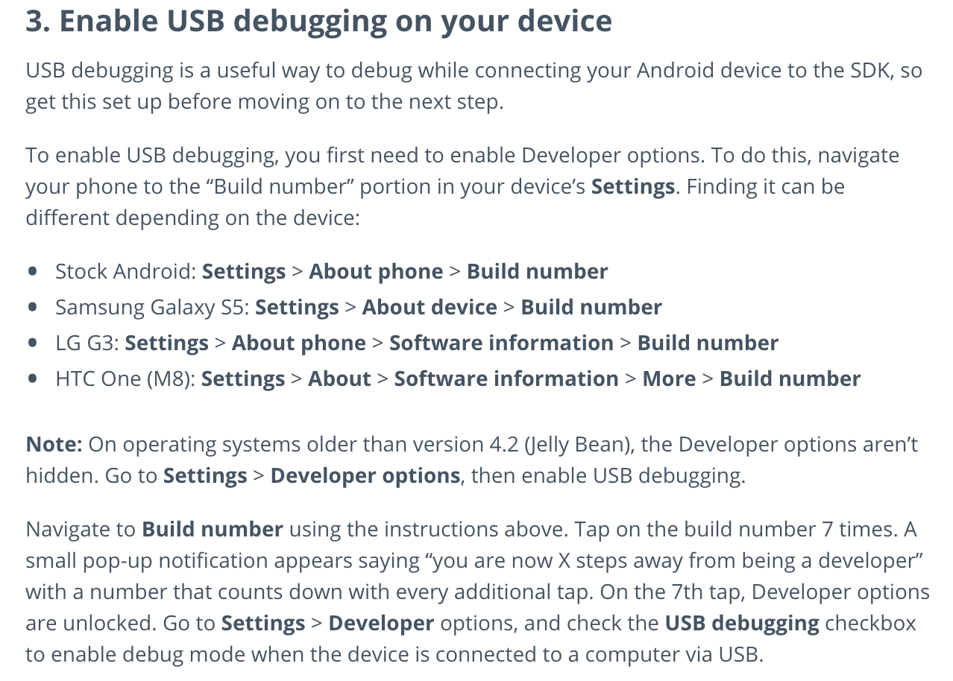
Notes:
https://docs.unity3d.com/Manual/android-sdksetup.html

Slide 17
Connect your phone to your computer using a USB cable.
In File > Build Settings, select Android as the platform by highlighting it in the Platform list and click Switch Platform.
Click the Player Settings... button, revealing the PlayerSettings section in the Inspector. Find the Other Settings section and do the following:
Enable Virtual Reality Supported. In the new Virtual Reality SDKs section, select the + icon, then select Cardboard to add it to the list.
Enter a package name into the Bundle Identifier field (for example,com.yourdomain.VRUnityDemo).
Set the Minimum API Level drop-down menu to [Cardboard] "Android 4.4 'Kit Kat' (API level 19)".
Click the Build and Run button.
Put the headset phone in your viewer and try out the demo!

Slide 18
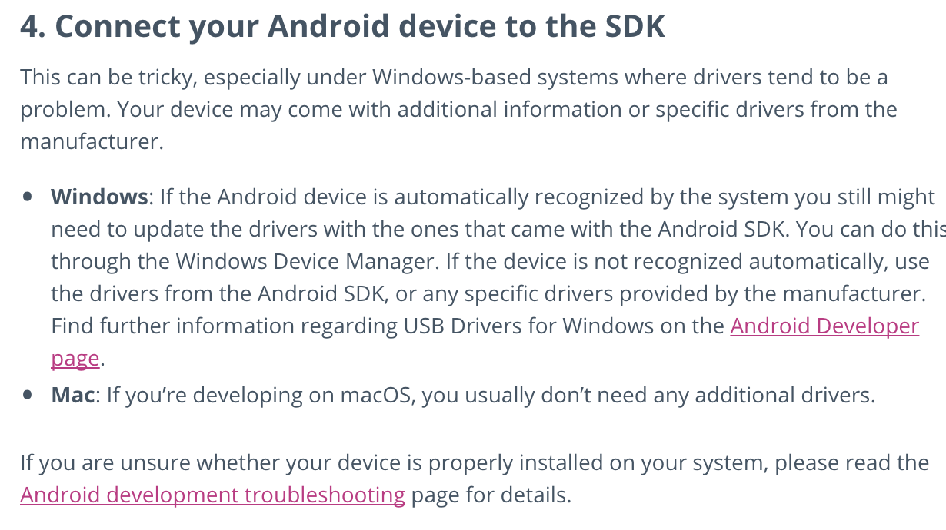

Slide 19
Add the Android SDK path to Unity
You will be asked to locate the folder where the Android SDK is installed. Select the whole folder. If you later want to change the location of the SDK, go to Unity > Preferences > External Tools

Slide 20
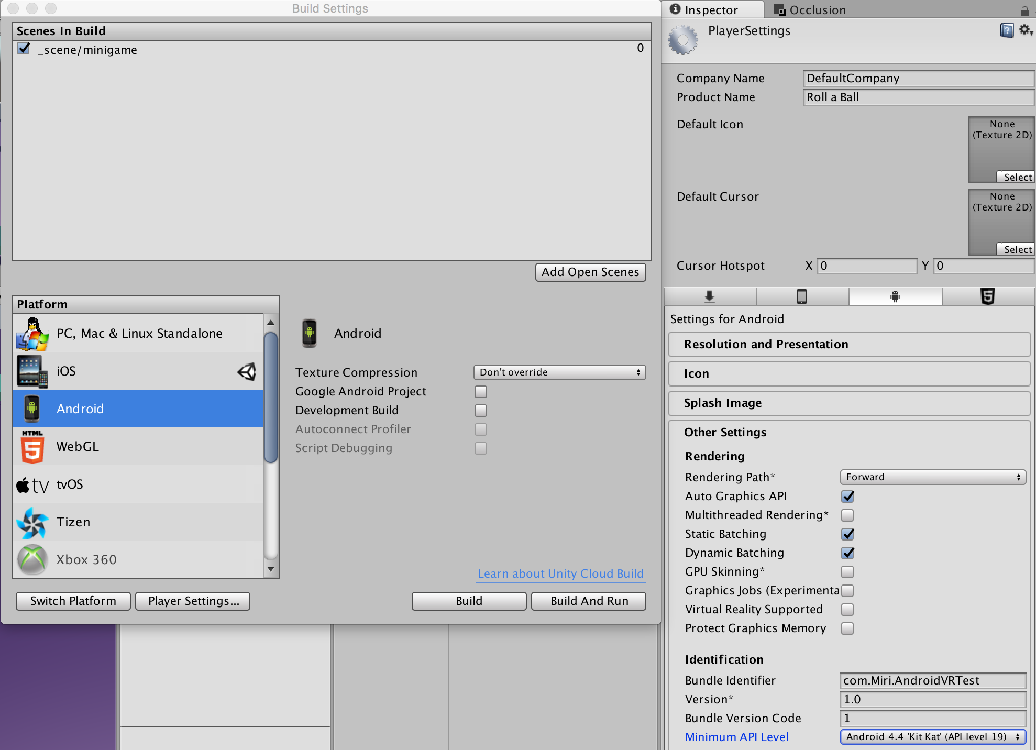
Pay attention to these parts!
Notes:
Player Settings > Bundle Identifier & Minimum API Level - set these according to the convention
When ready to build, must be Build And Run, not just Build

Slide 21
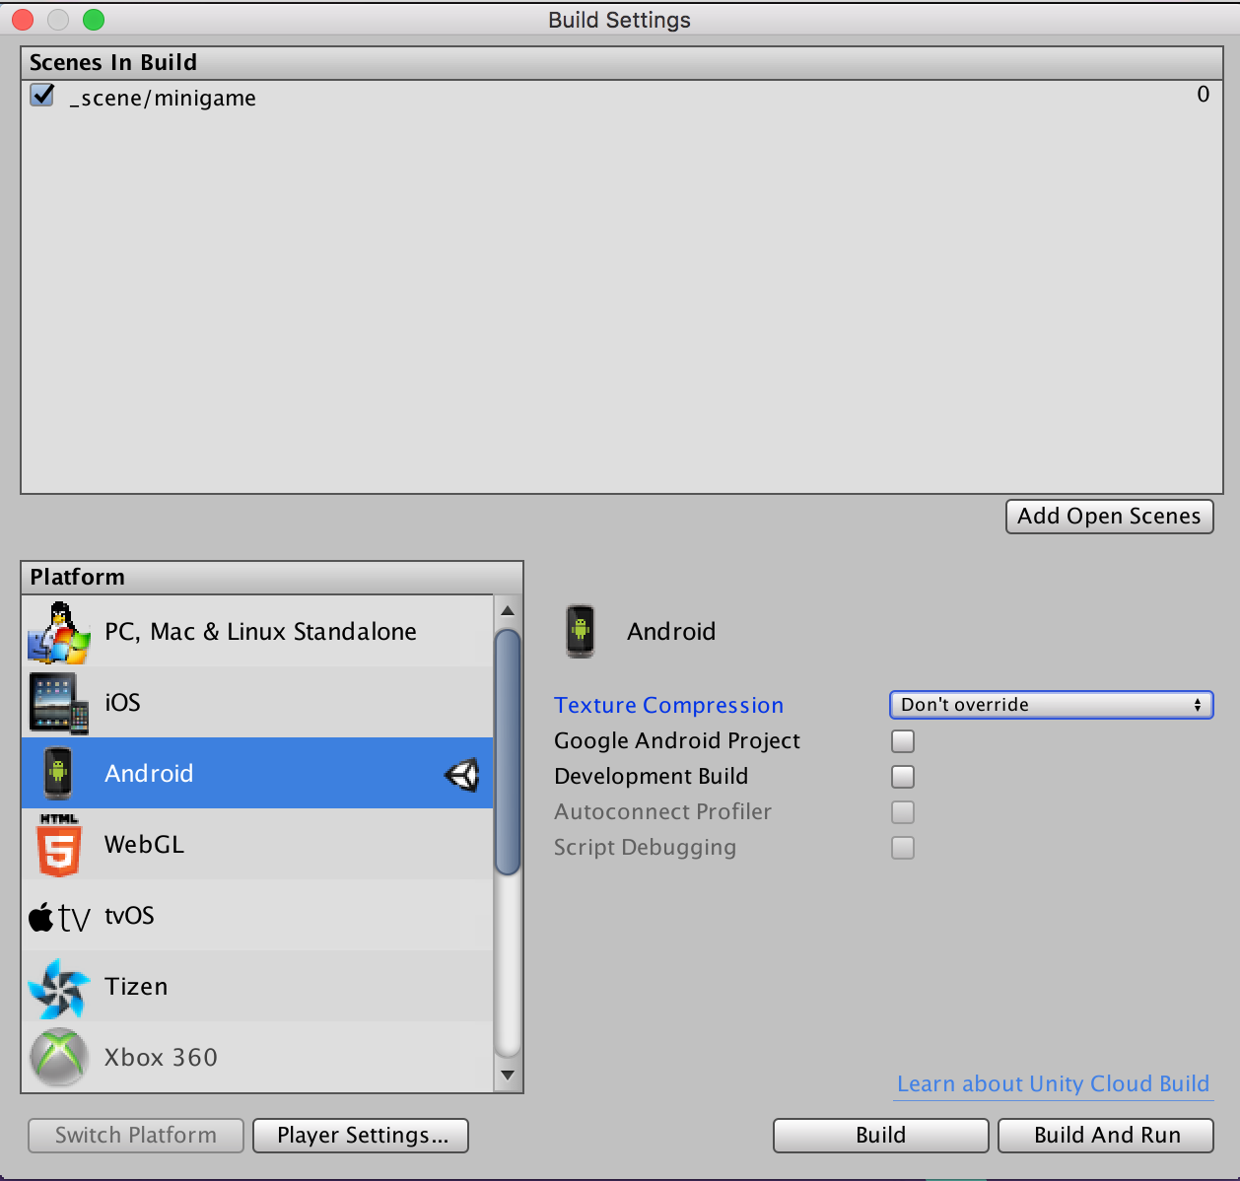
Connect device and select Build And Run

Slide 22
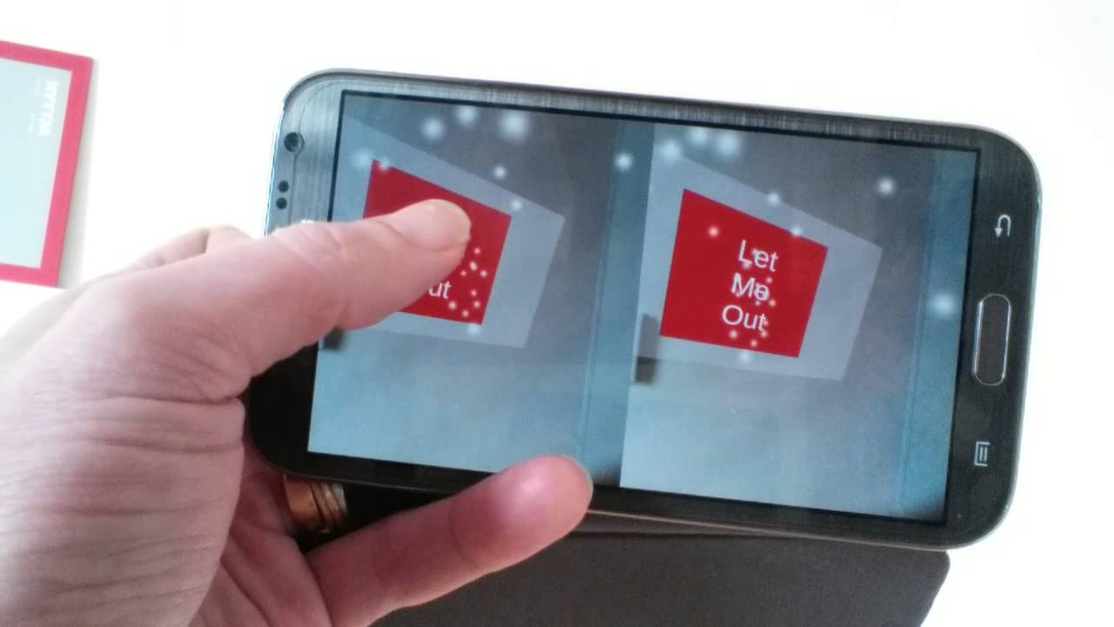
Success!
You should now have a new app with the Unity logo

Slide 23

Deploying to iOS
If you want to submit your app to the AppStore or integrate your Unity app with iOS to its full potential (Game Center, In-App purchases, team setup in development) you will need to get an Apple Developer account. BUT if you want to just run the iOS build of a Unity project on your own phone, a regular Apple ID is sufficient.
We will go with the Apple ID method, but later if you get serious about developing for iOS, you can explore how to get an Apple Developer account for free through Parsons.

Slide 24
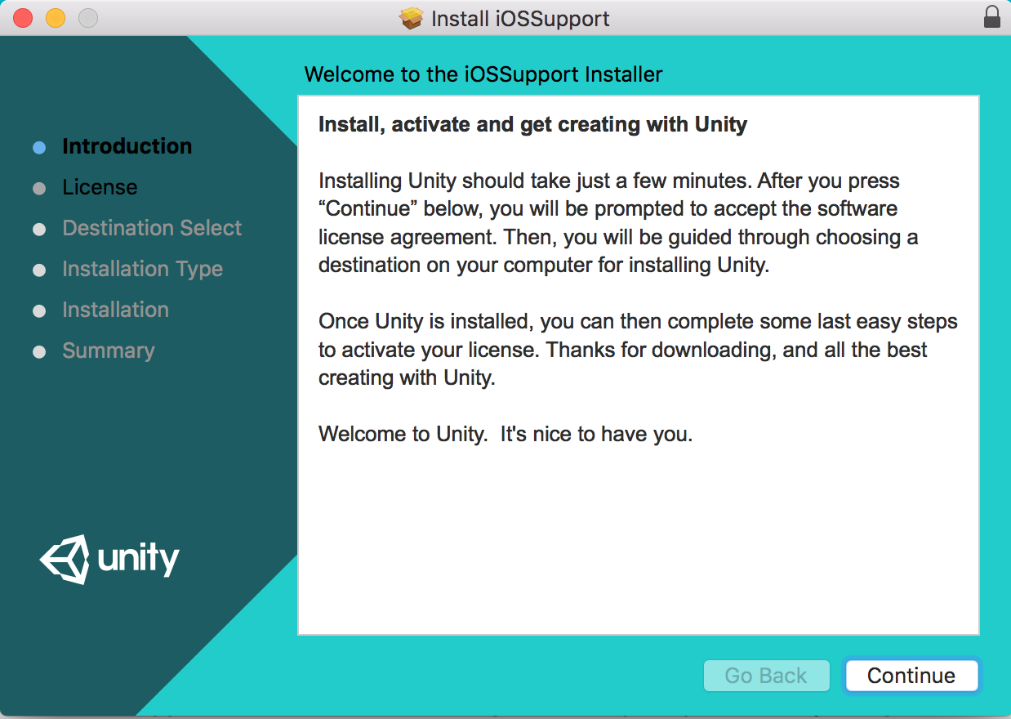
First, go to Build Settings in Unity and select iOS. This will prompt you to download the iOS setup package. Close Unity and let the package install.

Slide 25
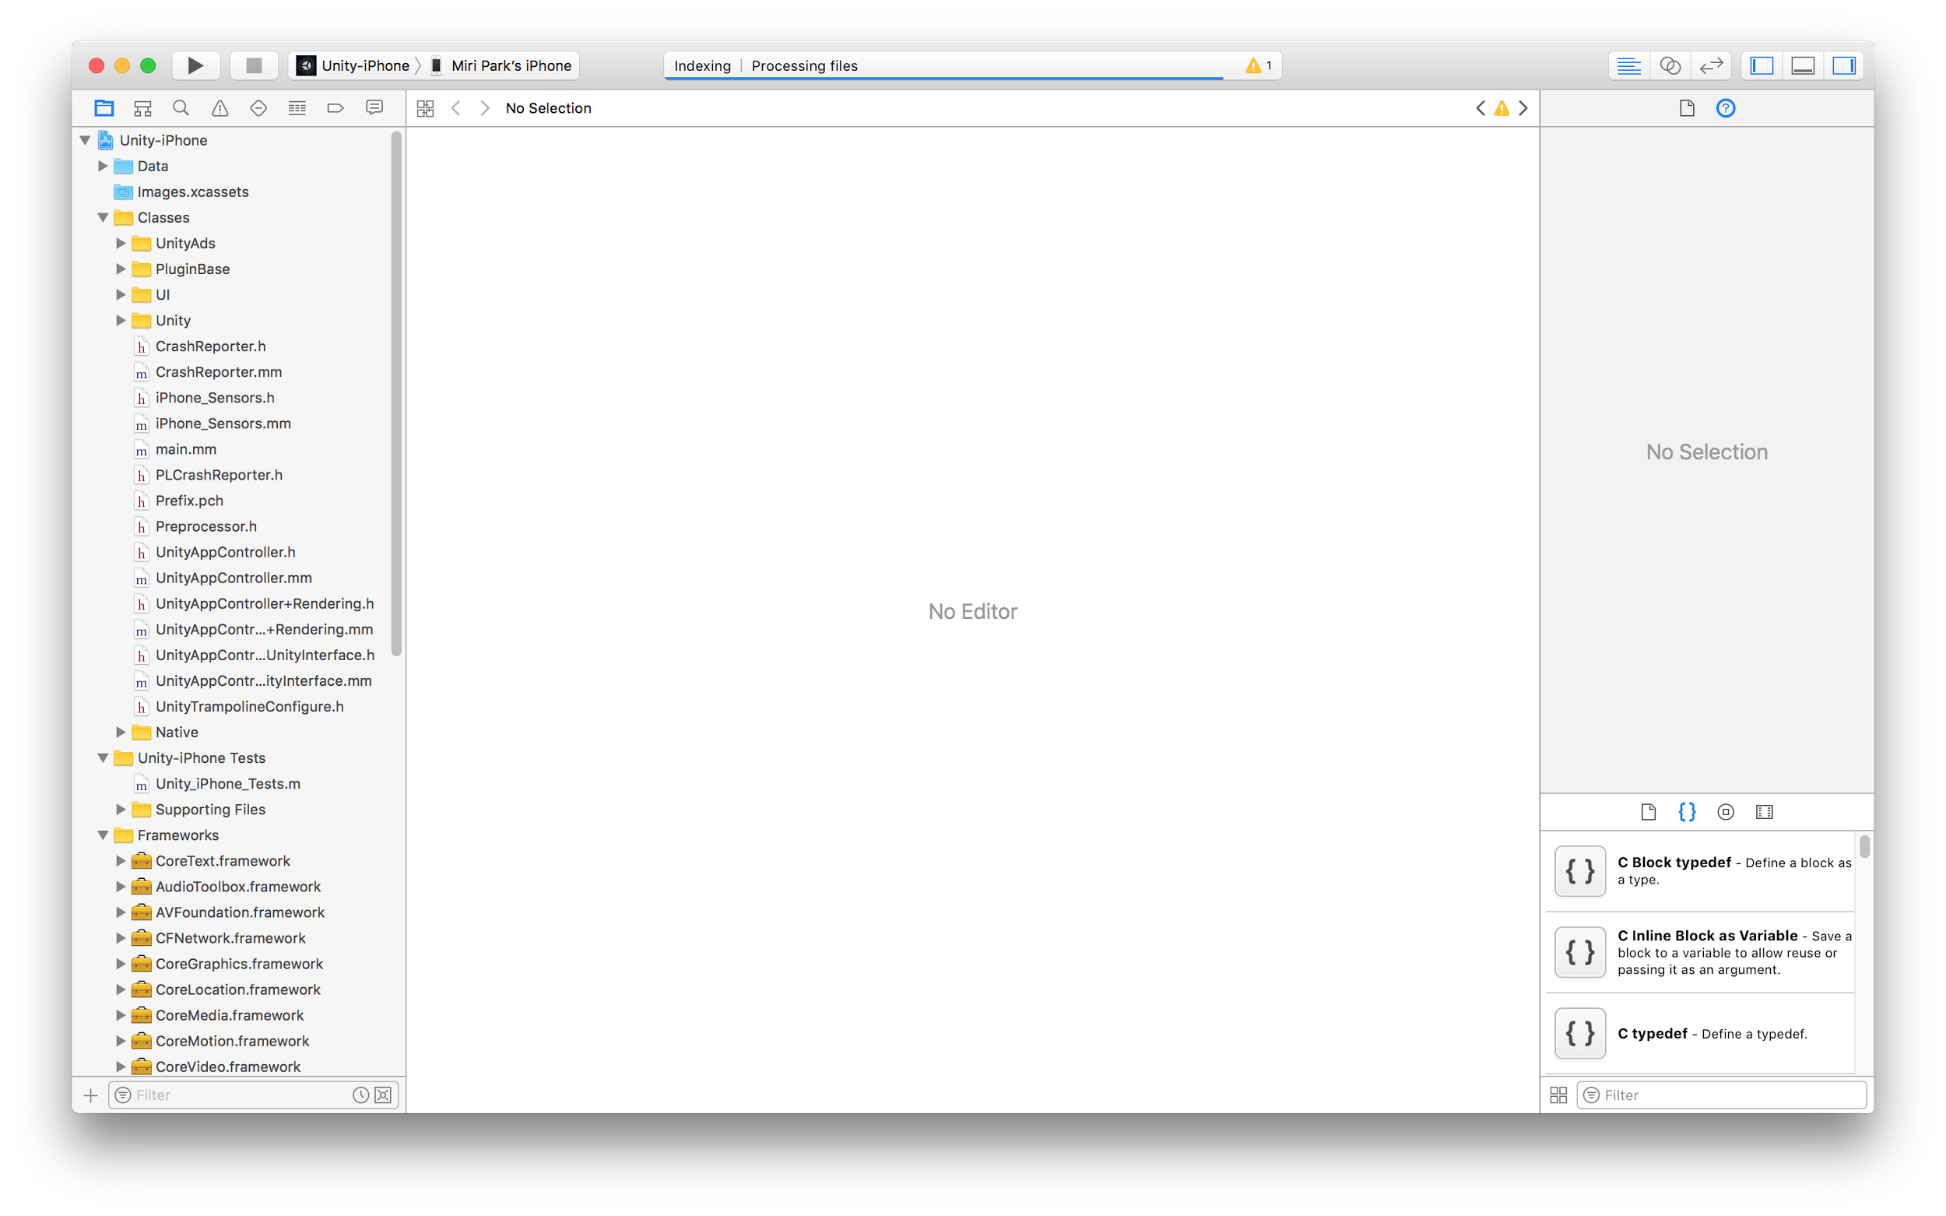
When you build to iOS from Unity, it will automatically generate a new XCode project in Objective C
(looks like openFrameworks but it’s not!).
Make sure your phone is connected and shows up in the build destination

Slide 26
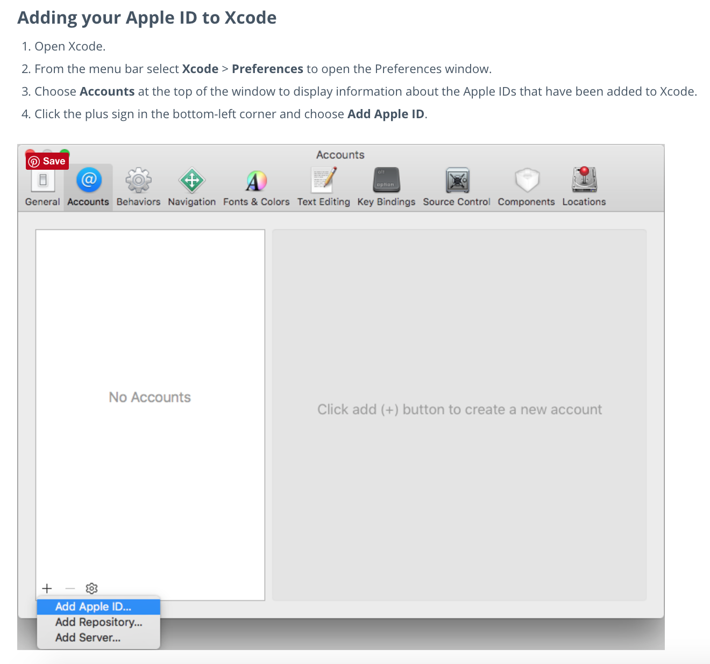

Slide 27
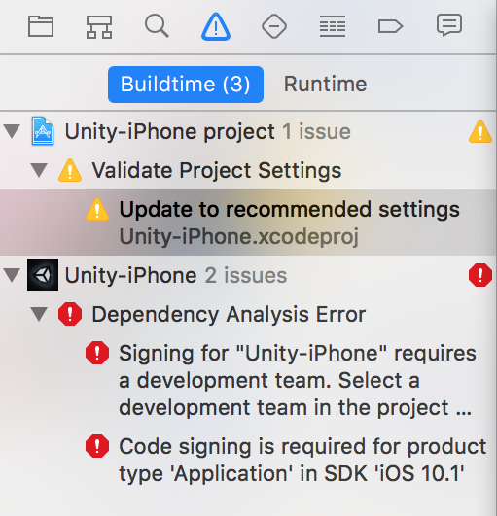
You might get a few errors… If you do, don’t fear! We might need to adjust the build settings.
Notes:
Follow instructions here if you are lost: http://stackoverflow.com/questions/37806538/code-signing-is-required-for-product-type-application-in-sdk-ios-10-0-stic

Slide 28
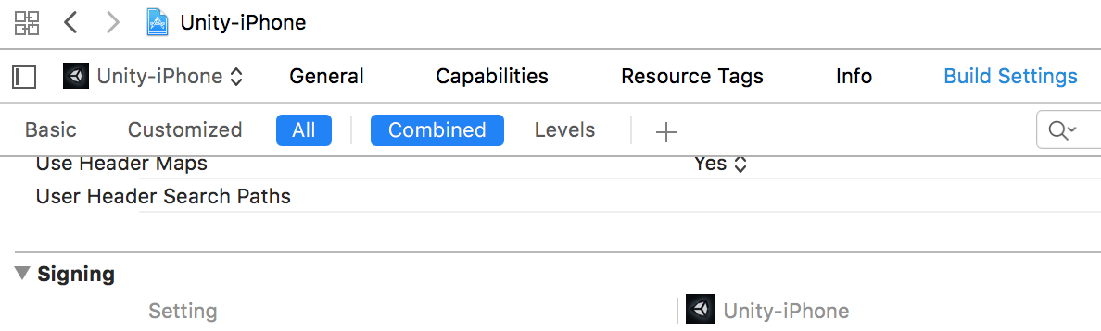
With Unity-iPhone selected, click on Build Settings, and scroll down to Signing

Slide 29
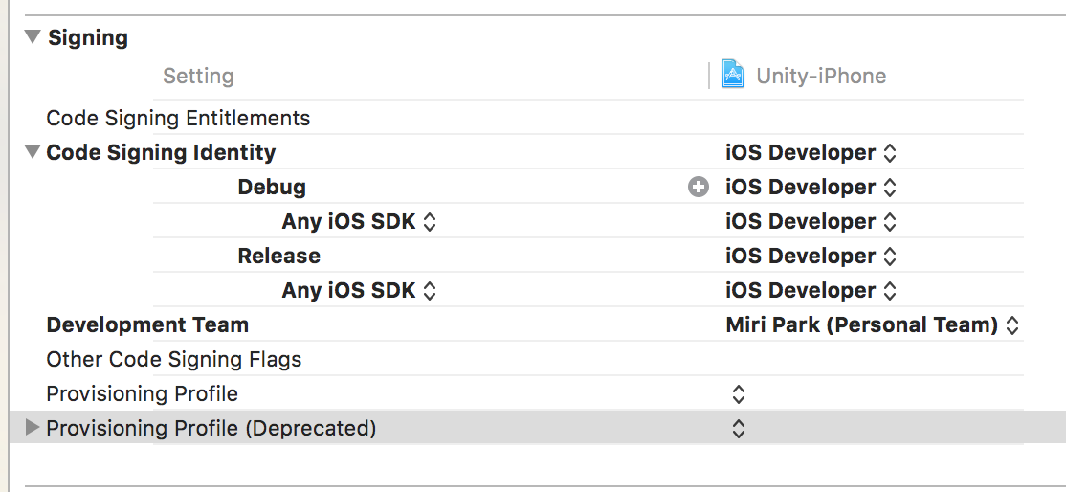
Set all the signing identities to iOS Developer,
Set Development Team to your own personal team

Slide 30
Do the same setting adjustment for all your build targets from the drop down menu here

Slide 31
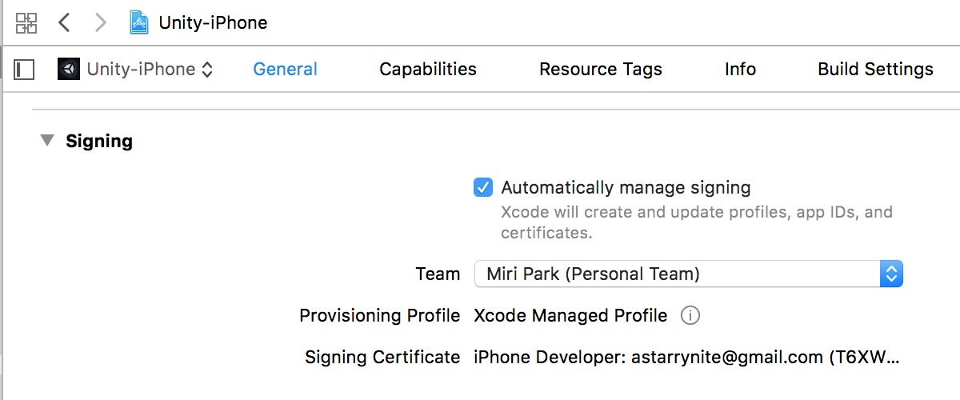
Now in General tab of your app
Set signing to Automatically manage signing,
Set Team to your own personal team

Slide 32
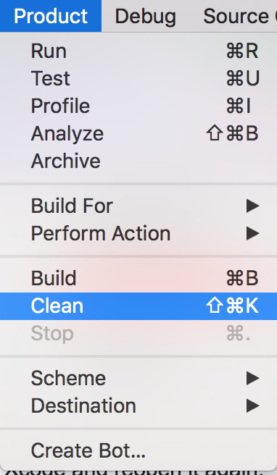
Lastly, go to Product -> Clean, to clean up your build with the new settings. Once that has completed, restart Xcode.
You should be good to go! Press play and let the build complete.
Your iPhone should now have a new app with the Unity Logo, with the name you assigned in the Unity build.

Slide 33
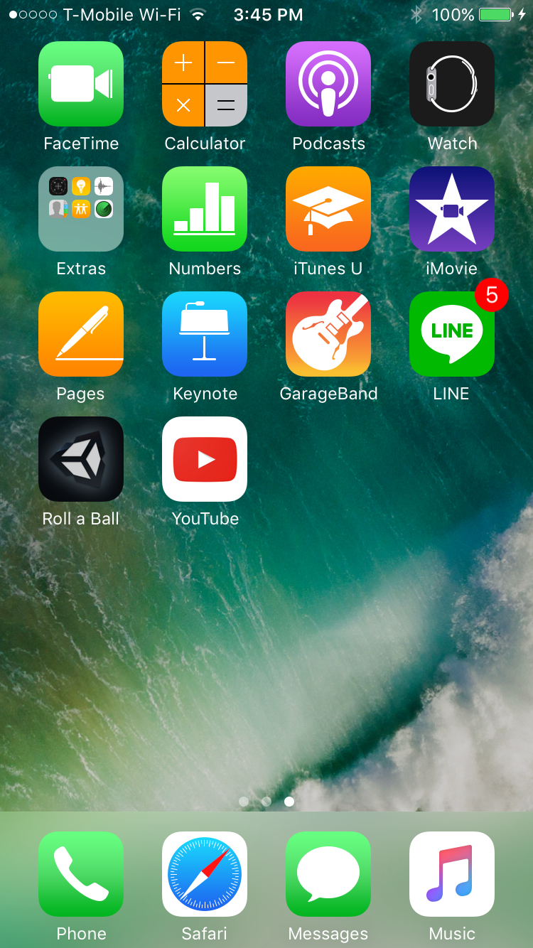
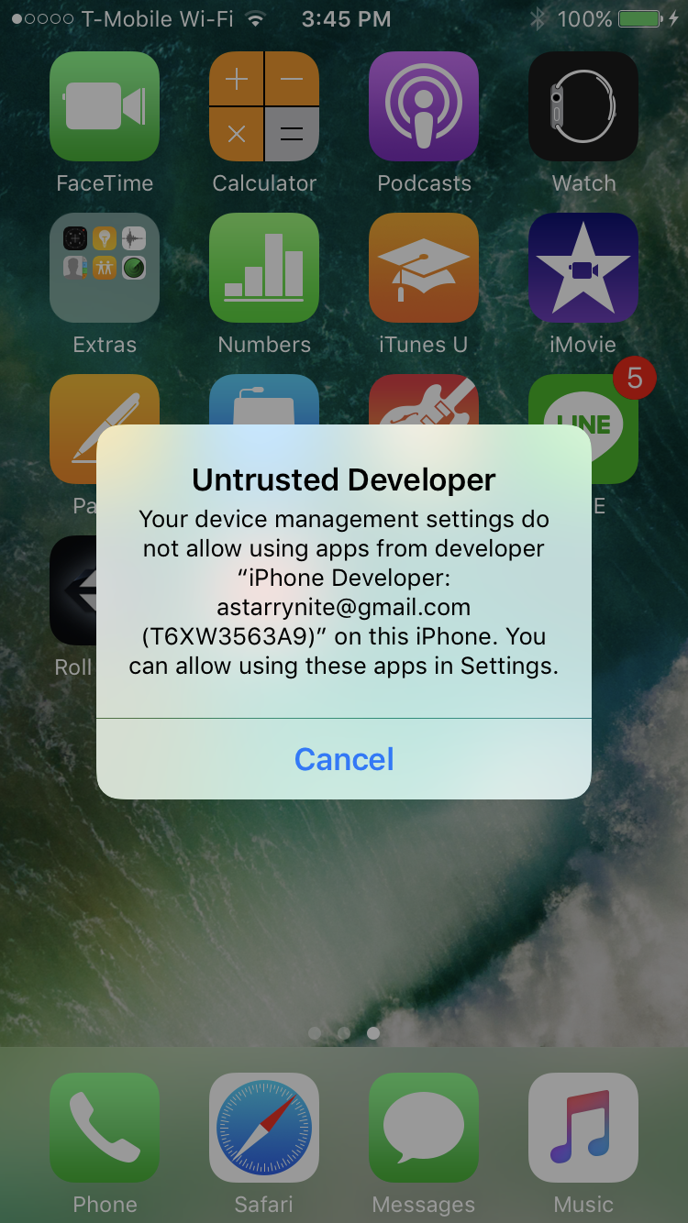
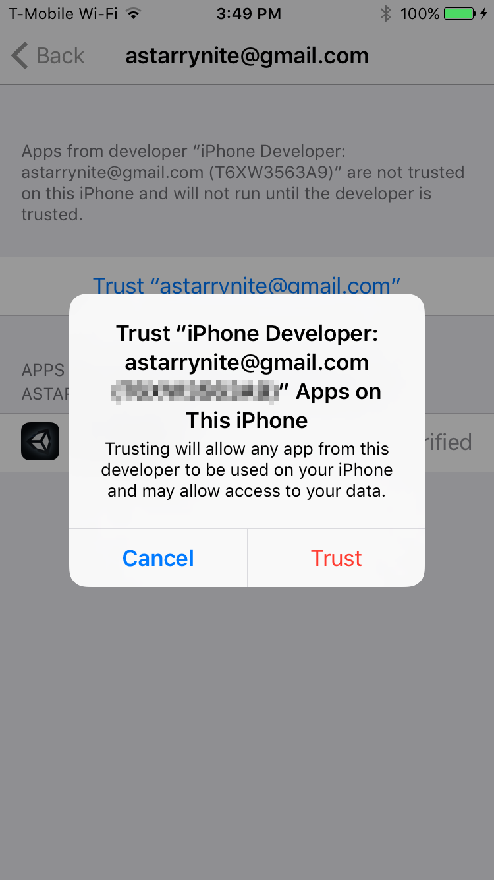
Seriously last step: your phone might not want to trust you as a Developer. Go into Settings -> General -> Device Management -> Your ID to trust yourself

Slide 34
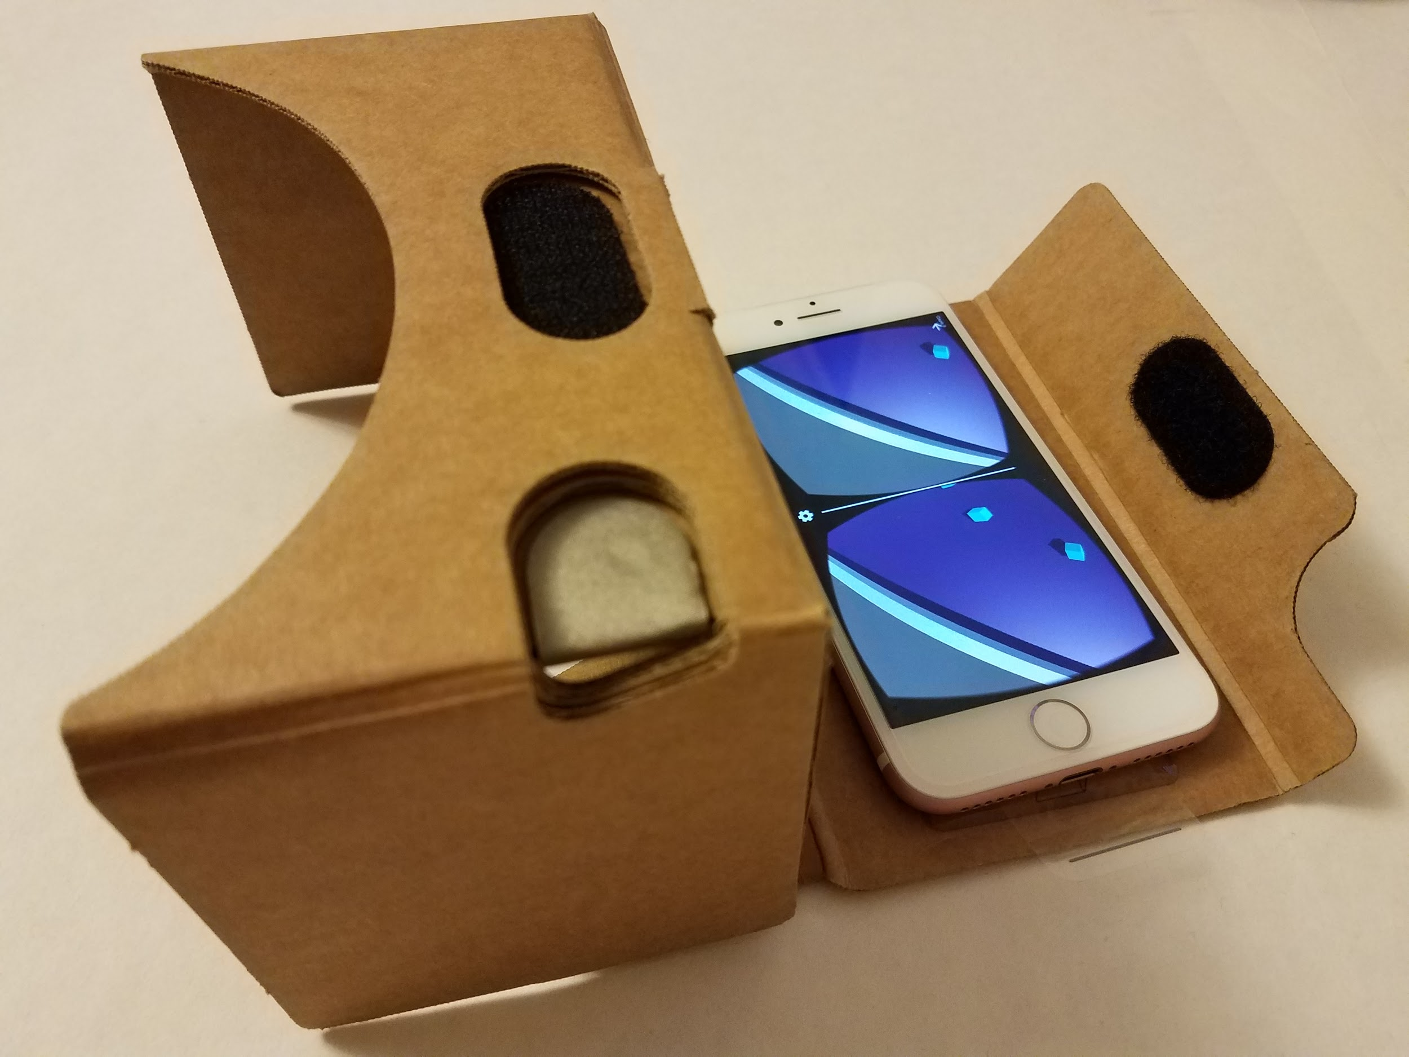
ᕕ( ᐛ )ᕗ

